Slide 1

NOTES NINJA
www.NotesNinja.tech
GitHub Repository - https://github.com/goswamiumang108/NotesNinja

Slide 2

Introduction to the Web Application
Welcome to Notes Ninja !! our revolutionary AI+ML & Neural Network powered web application designed to enhance learning through the power of Al and neural networks.
With user-friendly features and cutting-edge technology, we are here to transform the way you study and achieve success in academics.
By utilizing our web application, students can experience personalized learning, improved academic performance, enhanced study efficiency, and a deeper understanding of their subjects, ultimately leading to par-excellence in academic endeavors and a bright future ahed.

Slide 3

The Power of Al and Neural Networks Enhancing Learning Experience with Technology
Al in Education
Al has the potential to personalize learning, provide instant feedback, and adapt to individual student needs, leading to improved academic performance.
Neural Networks
Neural networks can analyze complex data, recognize patterns, and make data-driven predictions, empowering students to grasp difficult concepts and excel in their studies.

Slide 4
Technical Insights into Notes Ninja
Front-End Development Technologies :
At Notes Ninja, we harness the synergy of HTML, CSS, and JavaScript to craft an unparalleled client side web experience. HTML provides the robust structure organizing content into a coherent hierarchy making navigation intuitive. CSS then adds a layer of aesthetic appeal, with custom themes and responsive designs that adapt seamlessly to any device, reflecting Notes Ninja's commitment to accessibility and style. JavaScript brings it all together, enabling dynamic interactions and real-time features that empower users to manage their notes efficiently.
Back-End Development Technologies :
Behind the seamless operation of Notes Ninja lies the robust backend architecture powered by Python 3.11 and the Flask framework. Python's latest version brings cutting-edge features and optimizations that enhance the performance and efficiency of our server-side operations.
With Flask, a lightweight and flexible micro-framework, we've crafted a backend that is both powerful and easy to maintain. This combination allows for rapid development and deployment of new features, ensuring that Notes Ninja remains at the forefront of innovation.
Version Control System : Git and GitHub for VCS, collaboration, and CI/CD workflows.

Slide 5
Build and Deployment :
The global reach of Notes Ninja is powered by the Azure Cloud, ensuring that our website is accessible worldwide. Our deployment process is streamlined through a GitHub Actions build and deployment pipeline, which flawlessly integrates with Azure, allowing for continuous updates and delivery without compromising on performance or security.
Together, GitHub Actions and Azure Cloud create a powerful combination for automating, securing, and scaling the deployment of web applications, ensuring that developers can focus more on creating and less on the intricacies of deployment and infrastructure management.
DNS Records Management :
At Notes Ninja, we've streamlined our web presence through strategic DNS records management. Our domain, NotesNinja.tech, is configured to forward to our Azure-hosted website with URL masking and path forwarding, ensuring a seamless user experience. This is accomplished by creating A Records that point to Azure's IP addresses, providing a direct and reliable route to our platform.
Additionally, we've verified our domain property with Google Search Console using a TXT record, which not only enhances our site's discoverability but also fortifies our credibility in the digital space by helping in SEO works.

Slide 6
Server side capabilities :
Notes Ninja is hosted on an Azure Linux server within the South India region, ensuring global accessibility. Key performance metrics include CPU usage, memory consumption, and data traffic. The free F1plan provides 1GB of storage and memory each with 60minuter per day of compute time. It uses an Python 3.11 runtime stack for handling server-side operations. NotesNinja has its own personalized virtual environment for running python scripts, managing dependencies, securely storing essential env variables, and API keys & secrets. It has Unix 5.15.128.1 OS version on a 64bit system with 64bit processes and two processors.

Slide 7
Key Features of Notes Ninja
Efficient Study Material
Our application transforms lengthy textbooks into concise, easy-to-understand study notes, saving valuable study time and aiding in better retention of information.
Accessibility and Convenience
Study anytime, anywhere with our mobile-friendly platform, allowing students to access study material conveniently and make the most of their study time.
Priceless product at no cost
The Notes Ninja comes at no cost for everyone. Credit Cards, billing info, Signups, etc. are not asked.
Multiple Data Files Supported
Users can upload multiple files of numerous types viz. PDF, JPEG/JPG, PNG, BMP, TIFF, HEIF, DOCX, XLSX, PPTX and HTML.
Visual Learning Resources
We provide visual aids and interactive content to make learning more engaging, ensuring students comprehend and remember crucial information effectively.
Customized Learning Experience
Our platform allows students to customize study material w.r.t curriculum to best suit their individual learning preferences, making the learning process more tailored and effective.
Whole Library into a small Handbook
Notes Ninja can at a time take about 629146 to 838860 English lang words of input to prepare your concise notes.
OCRed Files are not required
PDF files and Images even don’t need to be digitized !! Notes Ninja can even understand from scanned PDFs, phone-clicked images.

Slide 8
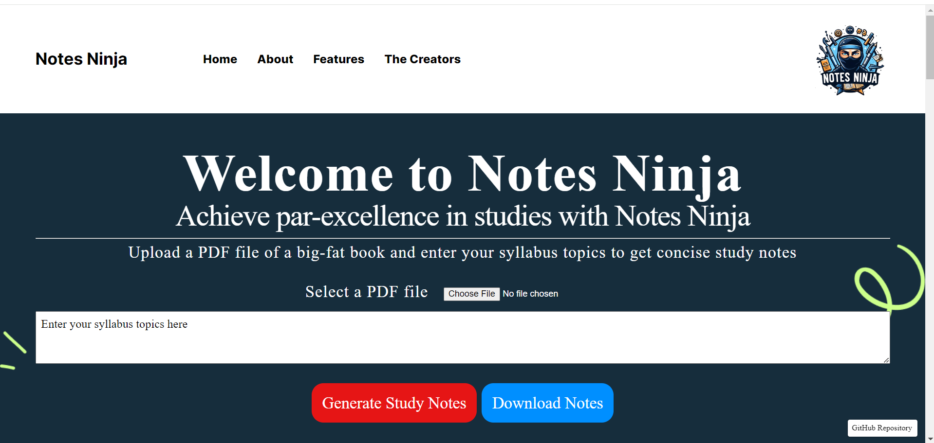
The Client-Side View Visit NotesNinja.tech preferably on PC to get better view

Slide 9
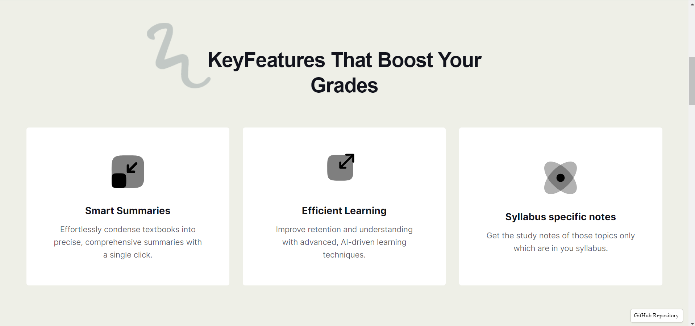
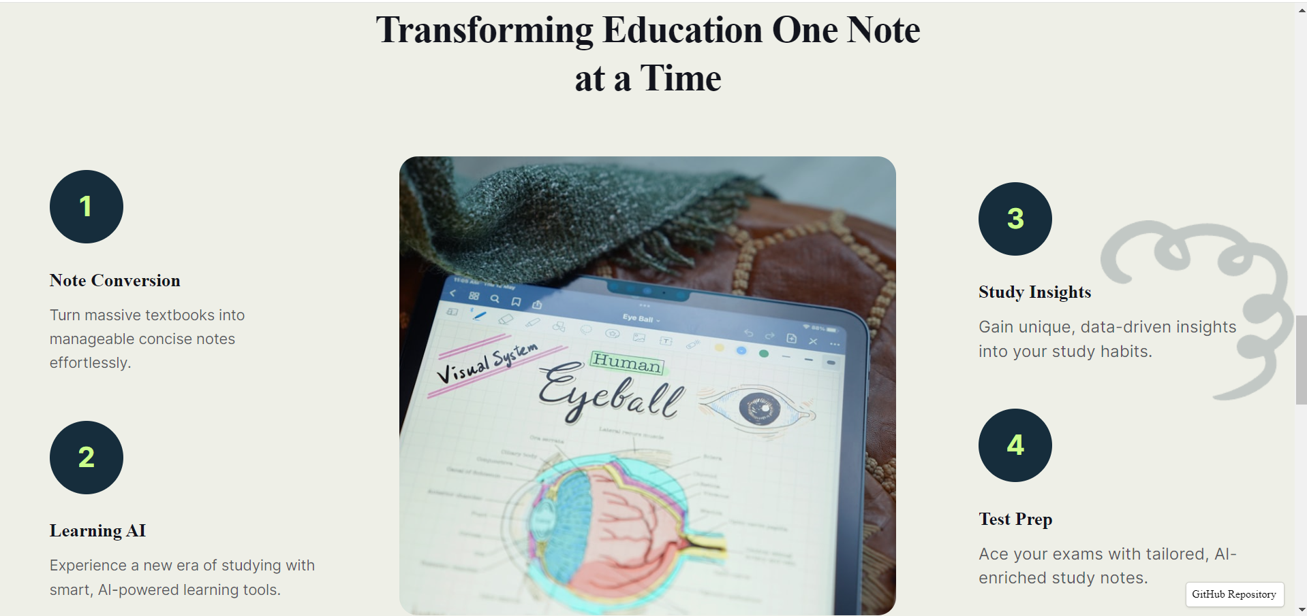
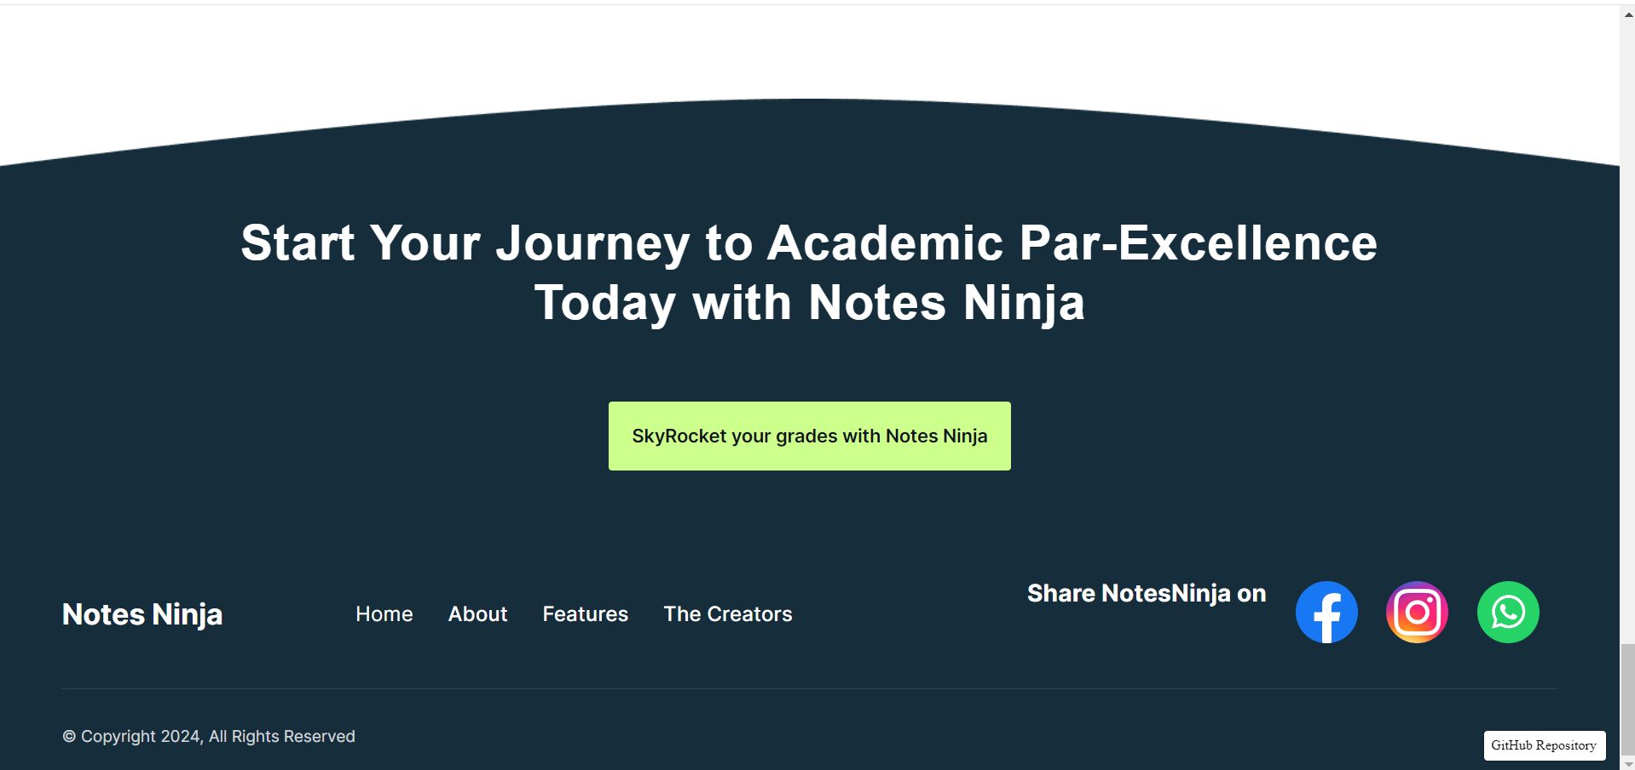
The Client-Side View Visit NotesNinja.tech preferably on PC to get better view

Slide 10






The Product Developers and their roles
@goswamiumang108
go.umang108@gmail.com
goswamiumang108@outlook.com
UMANG GOSWAMI
Product Idea and Project Lead
SHREYANSH
GUPTA
TEJASVA
CHADHA
SHASHWAT
TIWARI
Full Stack Development
Build, hosting & Deployment on Azure with GitHub Actions
Domain and DNS Records Management
Using various AI tools to parse-analyse-read the uploaded files , perform OCR, RAG workings and later generate notes and download them.
@Moriarty2004
@Tejasva1059
@Shashwat1915
UI/UX Design
Presentation Making
Logo and Graphics Designing
Load and Accessibility testing
Presentation Making
UI/UX Design
Performance and Usability testing
Domain Management
Proofreading
Backend Development
Endpoints and API Handling

Slide 11
Thank You
Submitted by
UMANG GOSWAMI (BTech CSE(AI-IBM) Section U Sem 4)
SHREYANSH GUPTA (BTech CSE(AI-IBM) Section U Sem 4)
TEJASVA CHADHA (BTech CSE(AI-IBM) Section U Sem 4)
SHASHWAT TIWARI (BTech CSE(AI-IBM) Section U Sem 4)
NOTES NINJA
www.NotesNinja.tech
GitHub Repository https://github.com/goswamiumang108/NotesNinja

